Slide 1

How to apply for conference and travel stipends from faculty?
PhD
(2023-2024)

Slide 2

Disclaimer
purely student initiative = primarily based on our experiences
  consulted with:
    department secretary Ivona Vrzalová and Office for Studies assistant Jiří Žoudlík
familiar with applications in Czech
  English versions can differ, please share your own experience with us
conditions updated yearly – changes in 2024, following years may differ a bit
  do not skip official documents
  only for stays abroad, not for Czech!
goal: to suffer less than is necessary

Slide 3
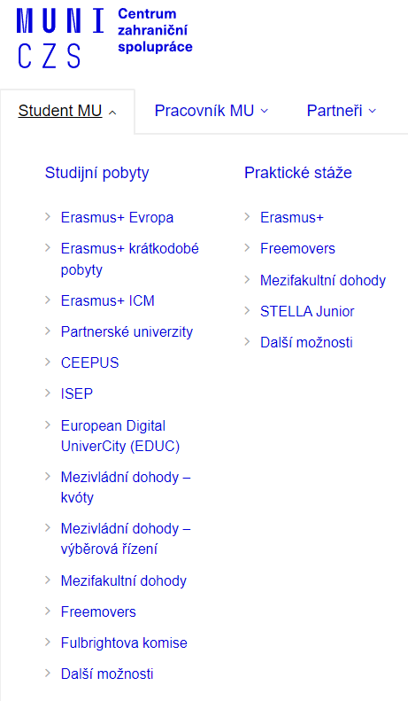







Mobility stipends
Center for International Cooperation MUNI
Specific network & grants
Faculty stipends MUNI
officially not limited
2 types - differs in length of stay
…
usually 1 month and longer

Slide 4
Types of faculty mobility stipends
www.phil.muni.cz/o-nas/organizacni-struktura/219913-studijni-oddeleni/stipendia
Podpora účasti studentů doktorských studijních programů na zahraničních konferencích
  for a stay/conference lasting a max. of 3 days (2023)
  for a stay/conference lasting a max. of 6 days (2024)
    -final amount newly reduced to 50-60%
Podpora mezinárodní mobility studentů doktorských studijních programů
  for a stay/conference lasting a 4 days and more (2023)
  preferentially supported stays lasting at least 30 days, but possible for 7 days and more (2024)
    -can be administered untill 20.11. 2024

Slide 5
Application procedure – before stay
Learning agreement (ISOIS)
Document server FF
-Dokumentový server-
(IS)
Internship and Stays
-Evidence údajů-
(IS)
Document Office
-Úřadovna-
(IS)
Podpora účasti studentů doktorských studijních programů na zahraničních konferencích
  for a stay/conference lasting a max. of 3 days (2023)
  for a stay/conference lasting a max. of 6 days (2024)
Podpora mezinárodní mobility studentů doktorských studijních programů
  for a stay/conference lasting a 4 days and more (2023)
  preferentially supported stays lasting at least 30 days, but possible for 7 days and more (2024)

Slide 6
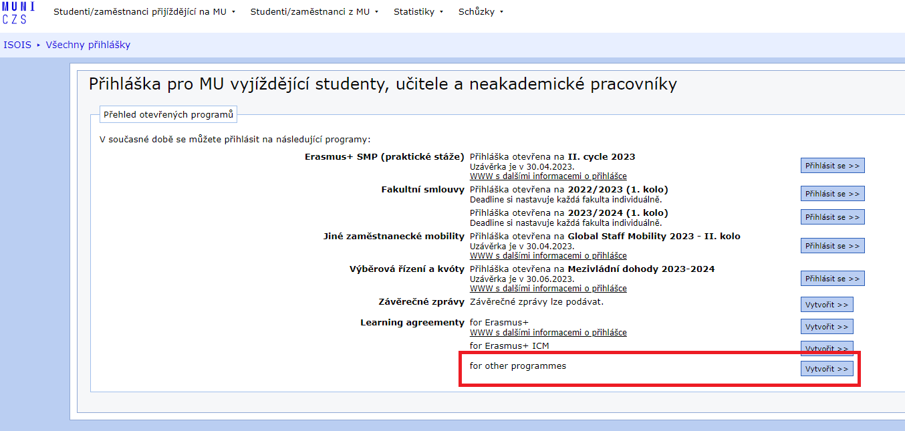
Application procedure before stay:
Step 1: Learning agreement
https://isois.ois.muni.cz/cs/outgoing-application/application/
only for a stay/conference lasting a 4 days and more (2023)
preferentially supported stays lasting at least 30 days, but possible for 7 days and more (2024)
must be signed by 4 parties:
  myself
  MUNI departmental coordinator – Kristýna Čižmářová (Jana Valtrová) – Study for Religions
  MUNI fakulty coordinator – Šárka Hakalisto
  coordinator of hosting institution
platform: ISOIS

Slide 7
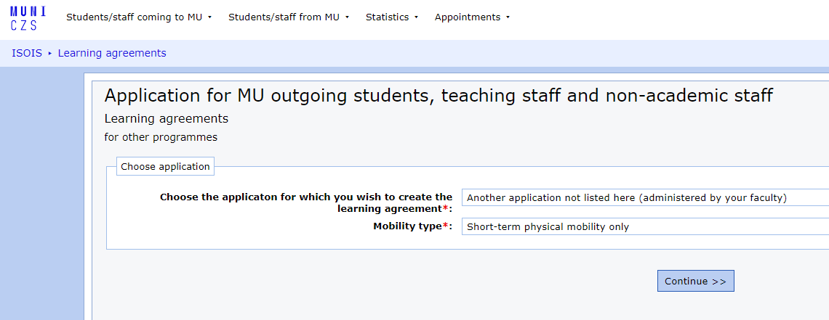
Application procedure before stay:
Step 1: Learning agreement
https://isois.ois.muni.cz/cs/outgoing-application/application/

Slide 8
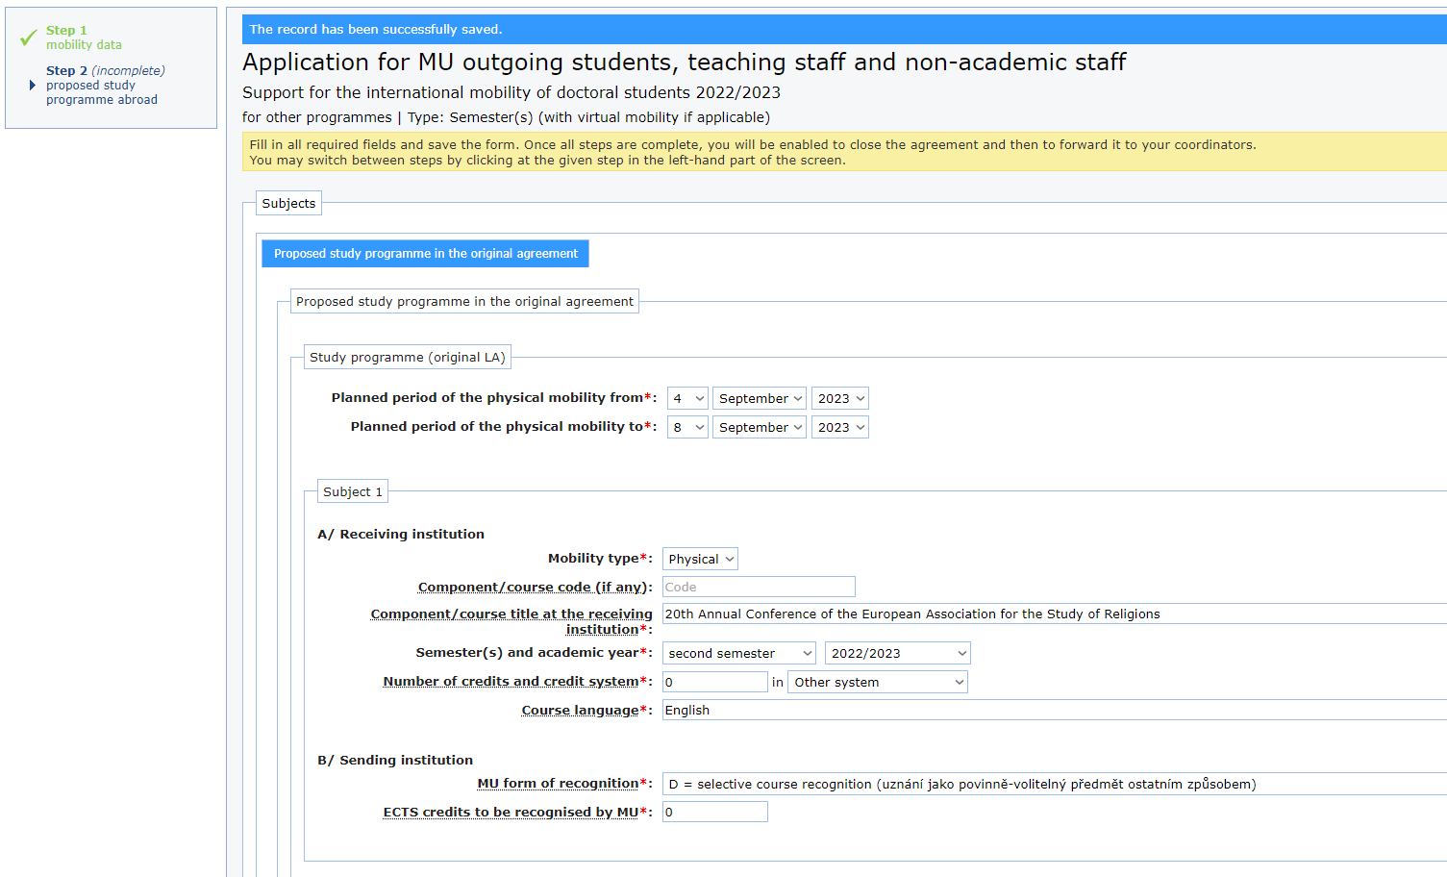
Application procedure before stay:
Step 1: Learning agreement
https://isois.ois.muni.cz/cs/outgoing-application/application/
official dates of stay
even if we have it as an enrolled course for credits

Slide 9
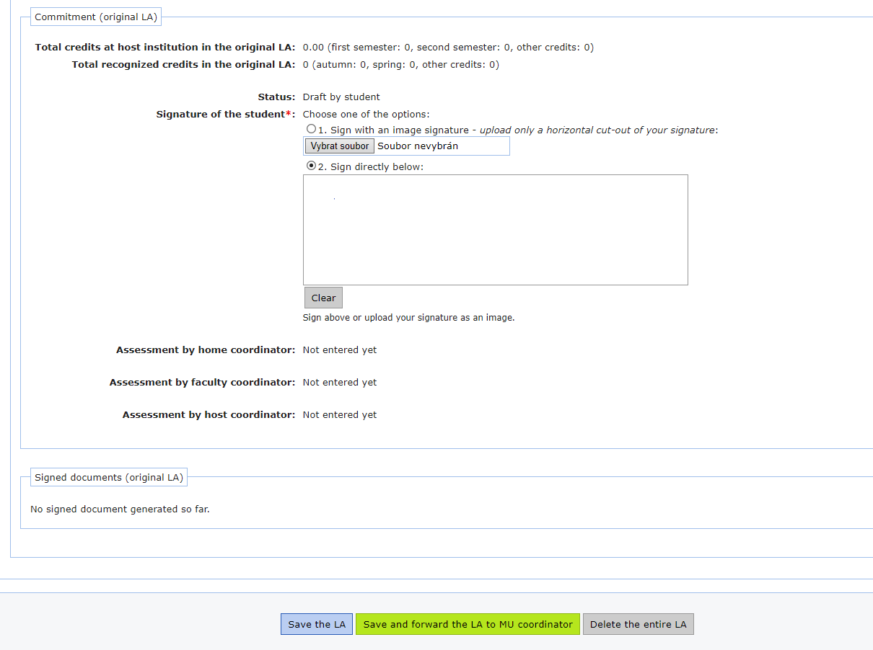
Application procedure before stay:
Step 1: Learning agreement
https://isois.ois.muni.cz/cs/outgoing-application/application/

Slide 10
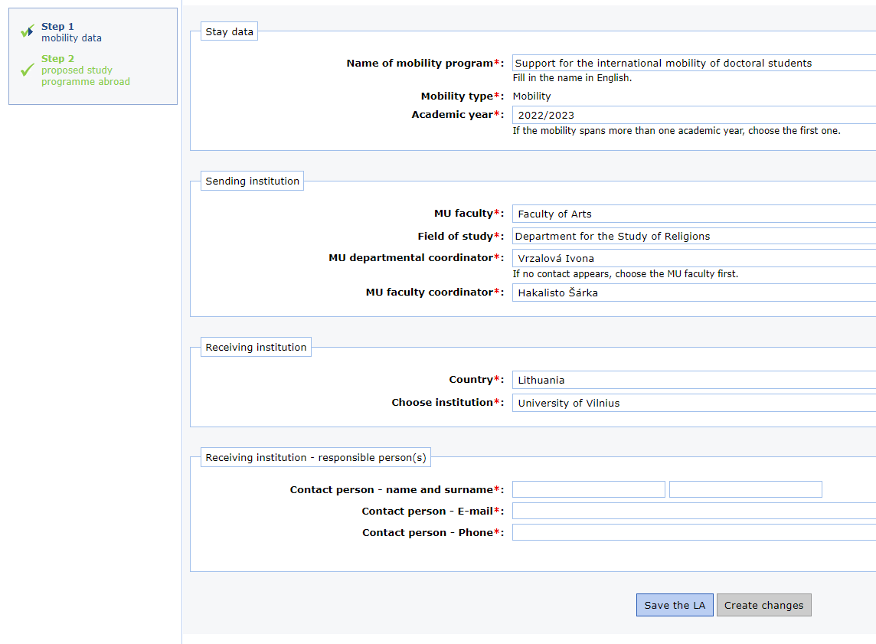
Application procedure before stay:
Step 1: Learning agreement
https://isois.ois.muni.cz/cs/outgoing-application/application/
newly Kristýna Čižmářová

Slide 11
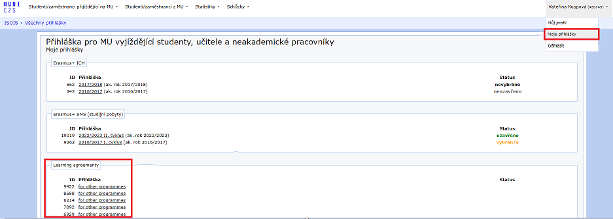
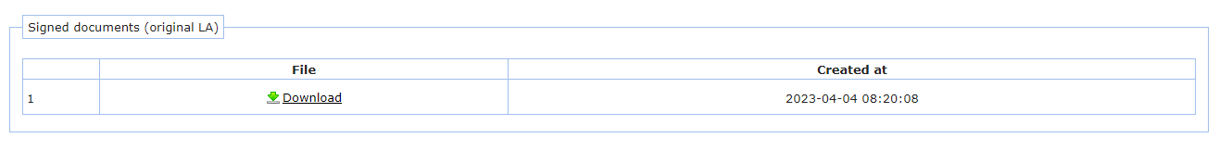
Application procedure before stay:
Step 1: Learning agreement
https://isois.ois.muni.cz/cs/outgoing-application/application/
  when finished you will get confirmation by email, if not, you can find it in ISOIS

Slide 12
Application procedure – before stay
Learning agreement (ISOIS)
Document server FF
-Dokumentový server-
(IS)
Internship and Stays
-Evidence údajů-
(IS)
Document Office
-Úřadovna-
(IS)

Slide 13
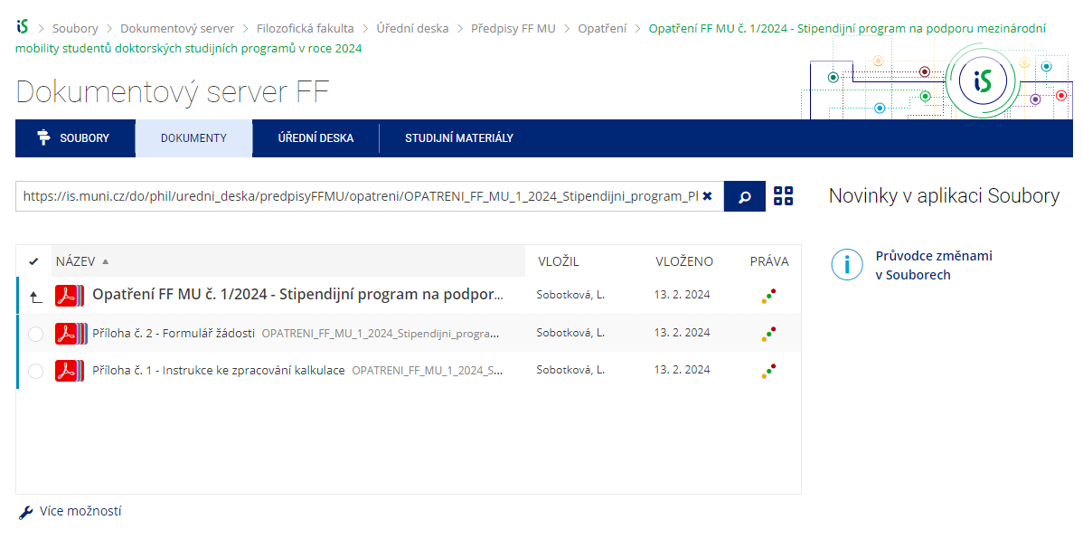
Application procedure before stay:
Step 2: Document server FF
https://is.muni.cz/do/phil/uredni_deska/predpisyFFMU/opatreni/OPATRENI_FF_MU_4_2021_stipendijni_program_PhD_mobilita_konference.pdf?info=1
https://is.muni.cz/do/phil/uredni_deska/predpisyFFMU/opatreni/OPATRENI_FF_MU_1_2024_Stipendijni_program_PhD_mobilita.pdf?info=1
for both types of stay/conference
documents:
Opatření FF MU (to read – general information about stipends conditions)
Příloha 1 – Instructions for making calculation (to read)
Příloha 2 – Application form

Slide 14
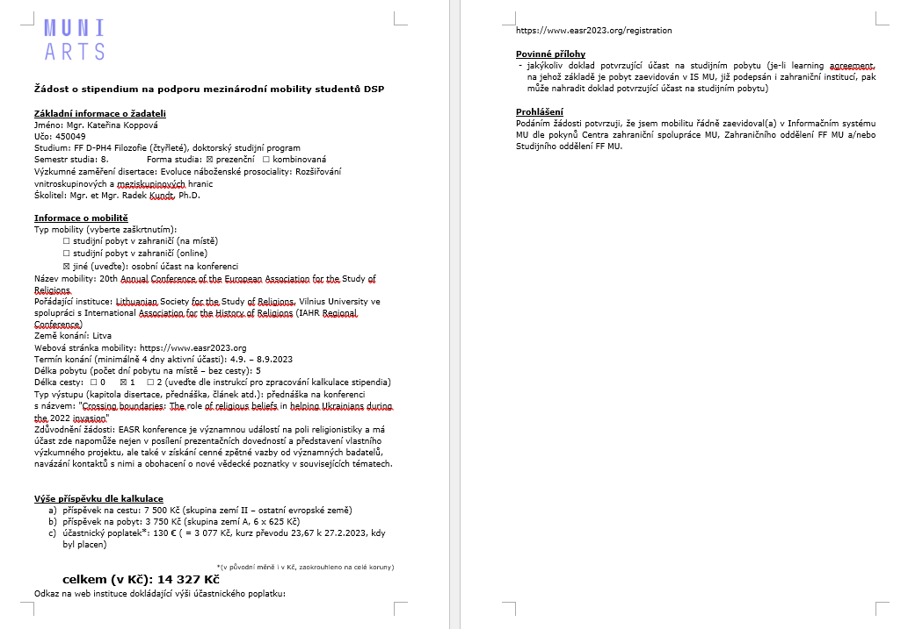
Application procedure before stay:
Step 2: Document server FF
+1/2 days extra for travelling
- for exact calculations see „Instructions for calculations“
-different amount for different countries

Slide 15
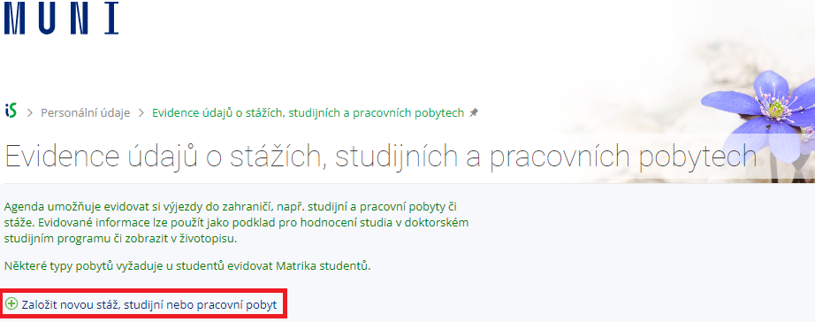
Application procedure before stay:
Step 3: Internship & stays – „Evidence údajů…“
https://is.muni.cz/auth/pers/studijni_pobyt
recommended for both types of stay/conference, necessary only for the longer stay (2nd type)

Slide 16
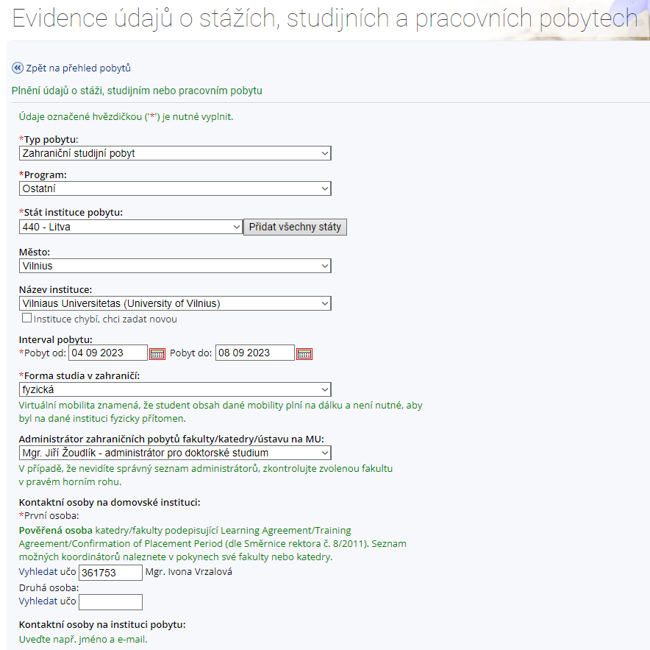
Application procedure before stay:
Step 3: Internship & stays – „Evidence údajů…“

Slide 17
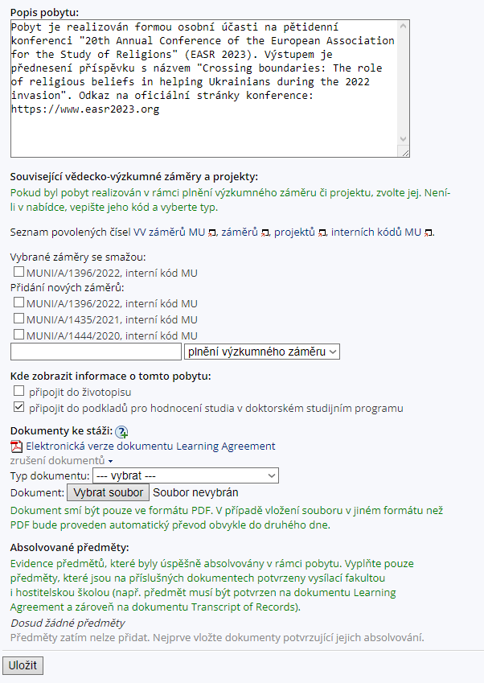
Application procedure before stay:
Step 3: Internship & stays – „Evidence údajů…“
consult with your supervisor
optional
Learning agreement
(4 and more days)

Slide 18
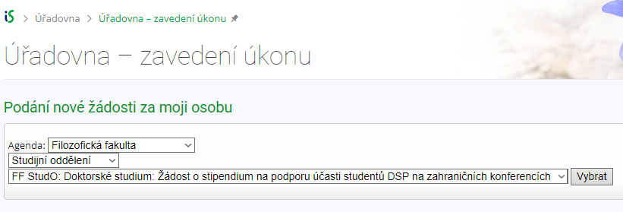
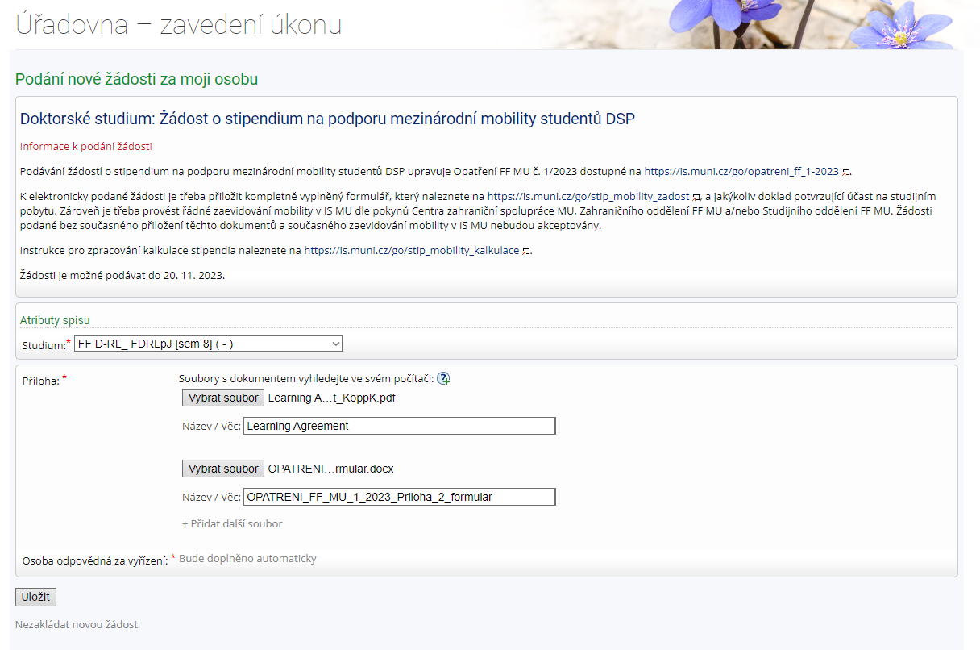
Application procedure before stay:
Step 4: Document Office – „Úřadovna“
choose type of stipend
filled in Application form
confirmation of acceptance:
    short-term: programme, acceptance email
    long-term: Learning agreement
not possible to save for changes!

Slide 19
Application procedure – after stay
Podpora účasti studentů doktorských studijních programů na zahraničních konferencích
  for a stay/conference lasting a max. of 3 days (2023)
  for a stay/conference lasting a max. of 6 days (2024)
Podpora mezinárodní mobility studentů doktorských studijních programů
  for a stay/conference lasting a 4 days and more (2023)
  preferentially supported stays lasting at least 30 days, but possible for 7 days and more (2024)
Confirmation of studies
Final report

Slide 20
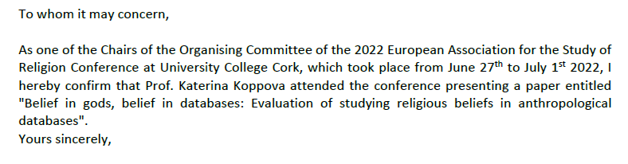
Procedure after stay:
Step 1: Confirmation of Studies
only for longer stay (2nd type)
upload to IS Internship & stays („Evidence údajů“) 30 days after coming back at latest
must contain:
  your name
  name of mobility
  date of mobility
  place of mobility
  confirmation of your participation
  our contribution (name of presentation/talk)
  date, signature & stamp of host institution
example:

Slide 21
Procedure after stay:
Step 2: Final report
for both types of stay/conference
approx. 1 page
must contain:
  your name, UČO
  name of mobility
  date of mobility
  place of mobility
  mobility description
  description of your contribution (presentation/talk)
  evaluation of your mobility
  date & your signature
  date & signature of your supervisor
send by email to phd@phil.muni.cz 30 days after coming back at latest

Slide 22
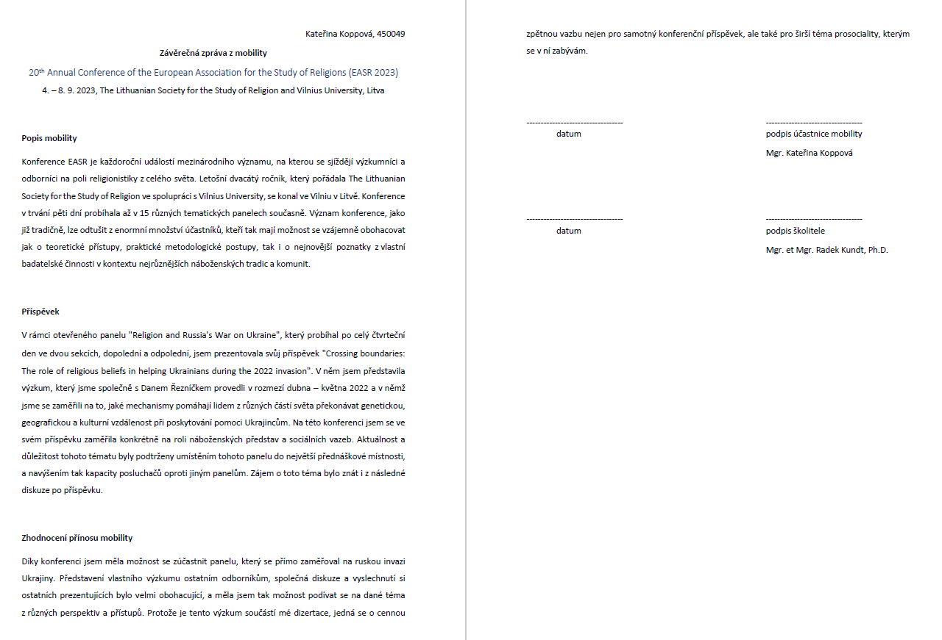
Procedure after stay:
Step 2: Final report

Slide 23
Congrats, you survived!

